Slide 1
Subtle Interaction Session #04
Course : GAME6012/ User Experiences
Effective Period : September 2017

Slide 2
Learning Objectives

Slide 3
Subtle interaction?
the art of seduction is a subtle and enticing game. We put people at ease with thoughtful questions. our gestures and glances direct attention. our words are chosen carefully, to invite favour and avoid offense. We know when to make decisions and how to present choices. Even serendipitous moments occur within the safety of a planned experience.

Slide 4
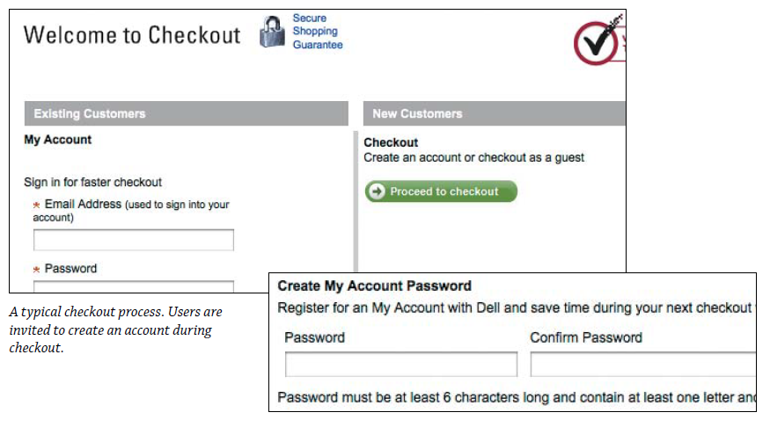
Do you want to continue?

Slide 5
Do you want to continue?

Slide 6
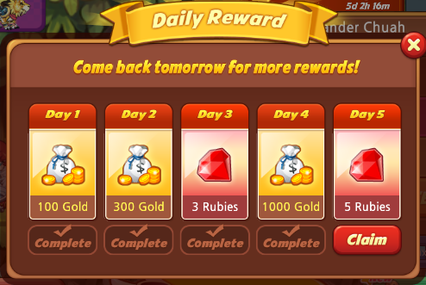
A feeling of progress

Slide 7
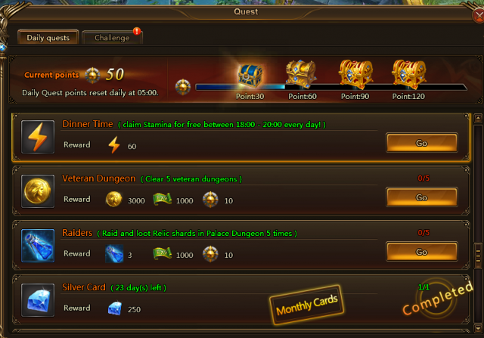
Sequencing the progress

Slide 8
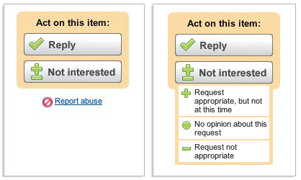
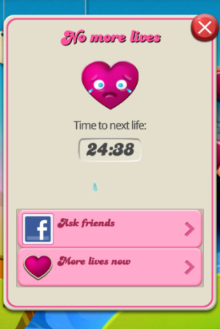
Shaping the progress

Slide 9
Limit introductory interaction

Slide 10
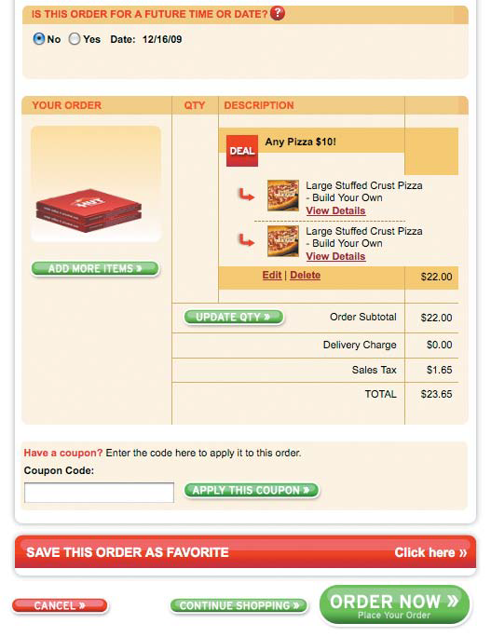
Use less text

Slide 11
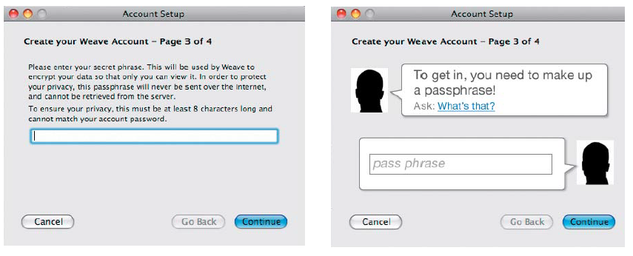
Compare

Slide 12
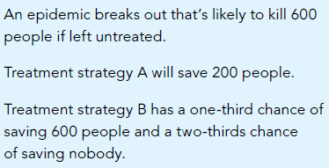
Which treatment?

Slide 13
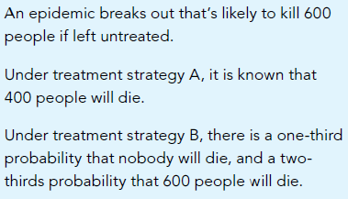
Which treatment?

Slide 14
Framing

Slide 15
Steps on checking your subtle interactions
Role-play the interaction
Script the narrative experience
Break down compound requests into simple next steps
Minimize choices(at each moment in time)
look for micromoments
choose clicks over characters (keyboard)

Slide 16
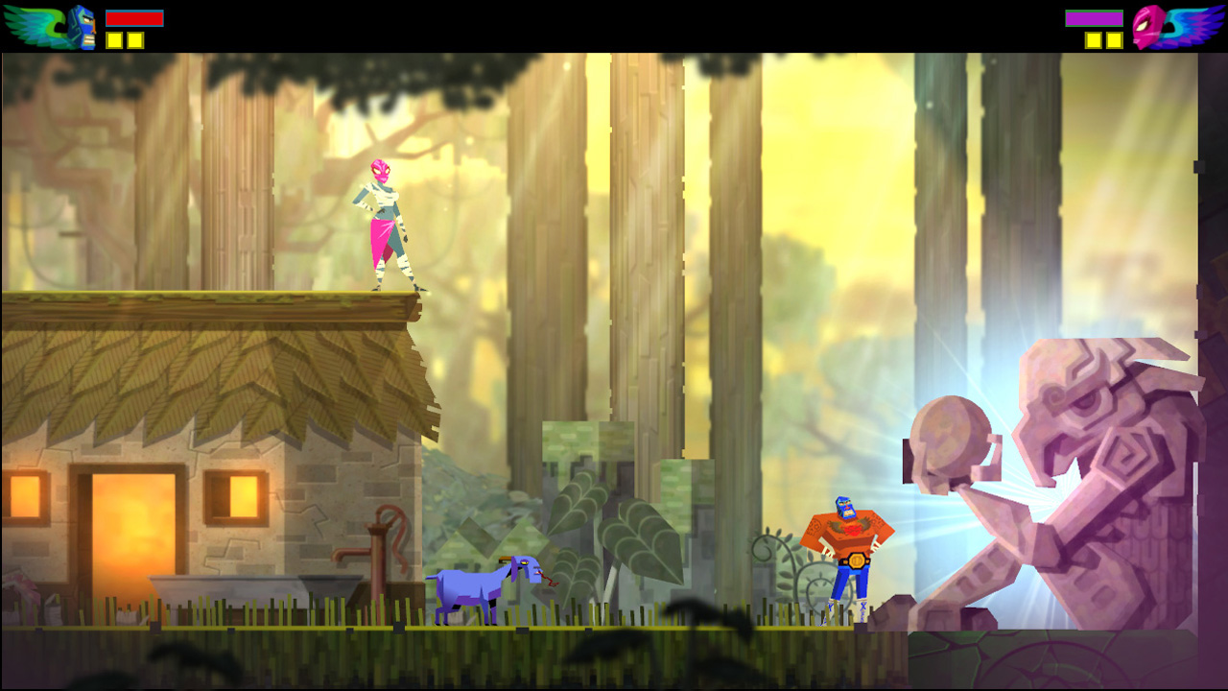
Case study
Guacamelle power up system

Slide 17
Assignment
Pick one of your favorite game
Re-imagine your first experience playing the game
Improve how the game introduce their game mechanics to the player
What feature that is needed to be reduced or introduced later in the game.

Slide 18
References
Buxton, William. 2007. Sketching user experience. Elsevier
Anderson, Stephen. 2011. Seductive Interaction Design. New Riders.
Faranello, Scott. 2016. Practical UX Design. Packt Publishing

